Slide 1
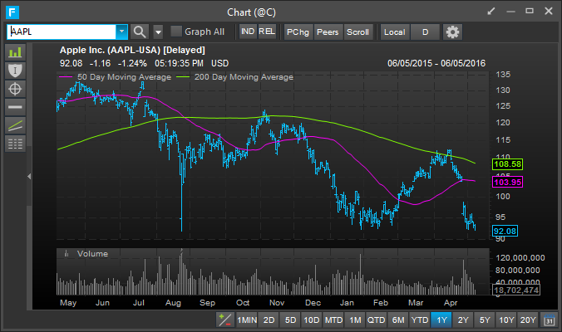
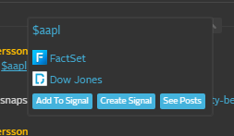
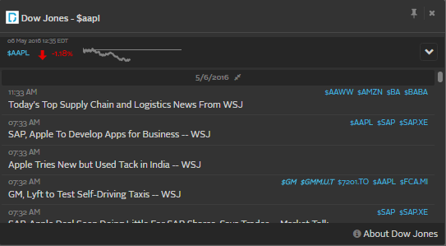
Standard ”hovercard” show basic details and app/entity links
Only sends in the actual cashtag text. Current rendering requires a certain format otherwise the input does not become a cashtag.

Slide 2
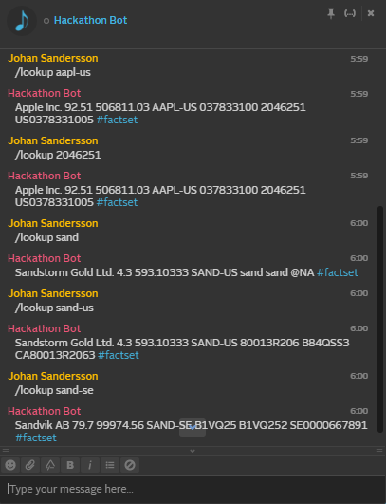
FactSet can understand and translate various identifiers
Proof of concept using a bot
Interesting example SAND vs SAND-SE

Slide 3
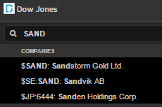
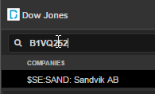
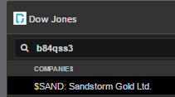
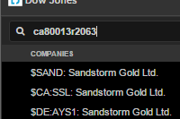
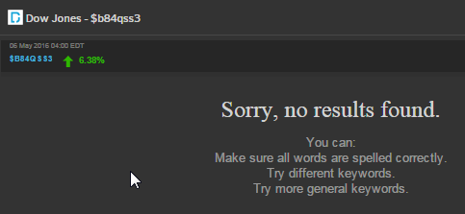
DJ understands several different identifiers
Linking currently limited to current cashtag functionality.
So this is definetely where we would add the new message type with the additional symbologies.

Slide 4
Conclusion 1
A free-form cashtag would allow both FDS and DJ to show information from more companies
More importantly, both companies could ”enrich” a basic cashtag with information as well as various identifiers for the instrument.

Slide 5
Use Case 1 – Standard Hover Card
No new functionality as such – but should each app use the same hover card?
This might be more of a question for the UI API . Some thought should probably be given to configuring which tools can get a hover card or rightclick context in case the list gets too big

Slide 6
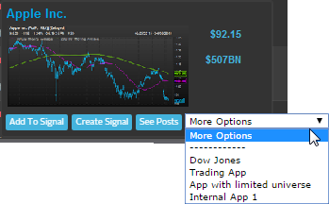
Use Case 2 – FDS renderer/Hover Card
The FactSet Hover Card could both display further information within Symphony as well as enrich the links to other applications so that apps without the same lookup capabilities could still find the right symbol.

Slide 7
Use Case 3 – DJ renderer/Hover Card
As previous but using DJ as the enricher.
This makes a lot of sense. The interesting bit is that each module could potentially enrich the symbology.

Slide 8
Conclusion 2
By allowing one of the user’s financial data providers to ”enrich” the basic cashtag into a Financial Object – you get a better experience within Symphony as well as provide connectivity to applications that do not understand the original identifier used.
By allowing each application to specify with identifiers it understands – links can be enabled/disabled based on what is in the enriched object.
If more than one module/data provider can ”enrich” the object – we also need some form of error or mismatch handling.

