Slide 1
FDC³
Program Summary

Slide 2
State of Desktop Interop in Finance
Countless Apps. Internal and Vendor developed
Digital Transformation
Many Platforms
Bilateral interop is expensive
Humans remain the primary interop layer
Notes:
Why OpenFin started FDC3:
High level of churn in App landscape as Vendors leverage new tech, and new fintechs produce more and more
Digital transformation within banks drives more internal development and new models taken from Web and mobile
Platforms (Bloomberg, Eikon, Symphony) offer some solutions with a walled garden approach - but they are incomplete - and organizations want their own as well
Interop today is usually done as one-off agreements between application developers
Or falls to the person at the desk to stich things together

Slide 3
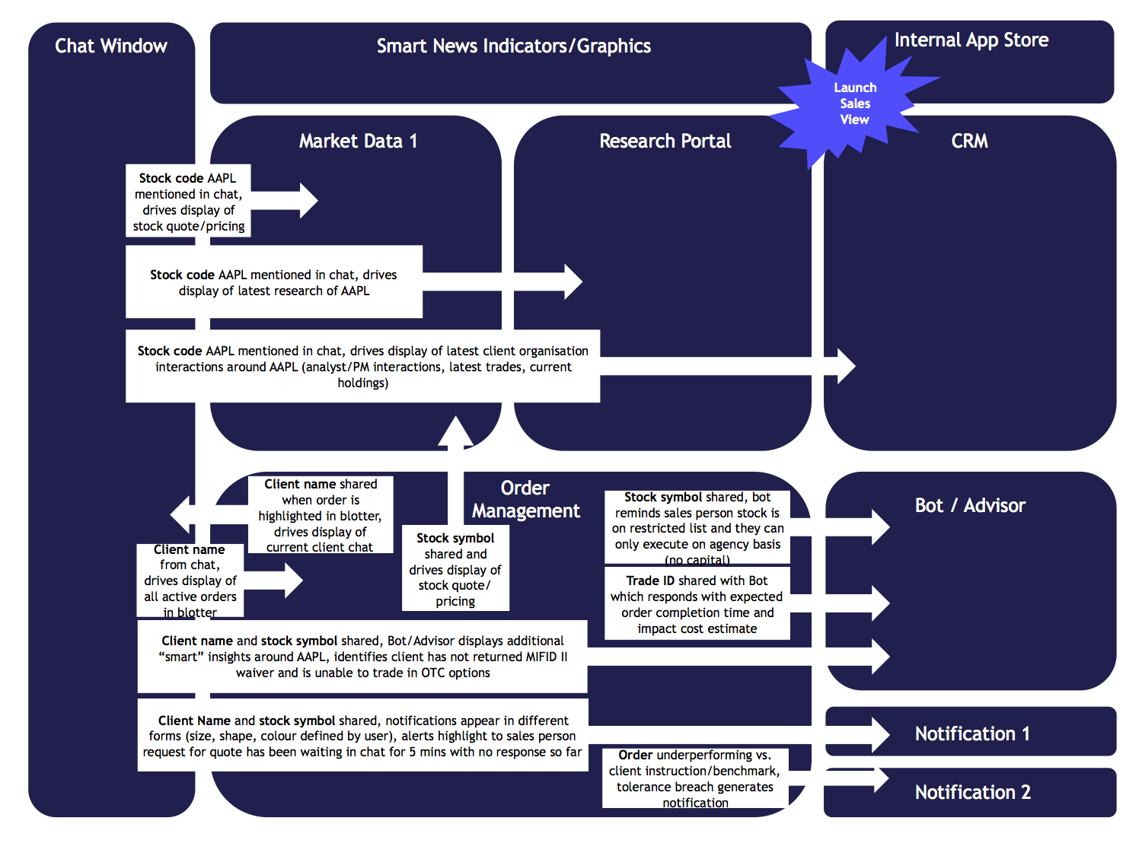
Workflows on a Financial Desktop
Today, each connection is bespoke
FDC3 standards make these automatic

Slide 4
What is FDC³?
Financial Desktop Connectivity and Collaboration Consortium
Industry wide standards
Socialization of ideas, problems and solutions
Reference Implementations
Part of the FinOS Foundation
Founded by OpenFin in 2017
Open Source - Apache 2.0

Slide 5
Who is participating?
Technical Working Group:
40+ Participating Organizations
major sell-side firms
major buy-side firms
cross-industry vendors representing:
Financial Data
Trading
Communication
Monthly meeting attendance of ~50 contributors
50+ members of the FDC3 Github Organization
Open participation - not exclusive to OpenFin or FinOS

Slide 6
FDC3 Working Groups
App Directory
Providing strong app identity and discoverability across the industry
Context Data
Defining common identifiers shared across the desktop
Intents
Creating common identifiers for financial workflows
API
Specifications of baseline APIs for interoperability
Use Cases
Identifying and detailing critical use cases for interoperability

Slide 7
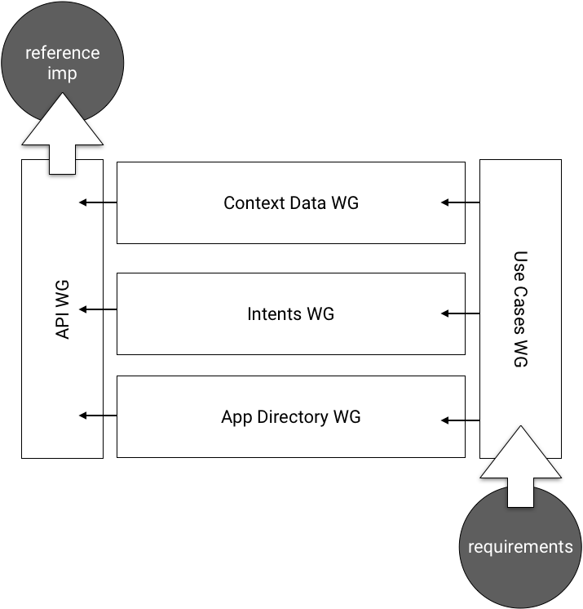
Working Group Flow

Slide 8
Resources
FinOS Confluence:
Overview
Context Data Working Group
Intents Working Group
App Directory Working Group
API Working Group
Use Case Working Group
Github:
Organization
Charter
Mailing Lists:
fdc3@finos.org
fdc3-pmc@finos.org

Slide 9
How to Get Involved
Join the mailing list: fdc3@finos.org
Document and share use cases
Participate in a Working Group
Implement the standards
Contribute to reference implementations
Provide feedback on proposals, drafts, and specifications
Contribute to the steering meeting

Slide 10
FDC³

